Slide 1
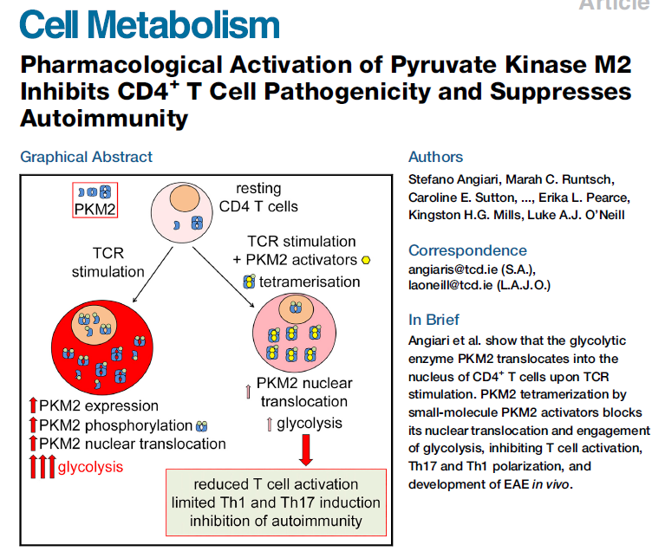

Slide 2
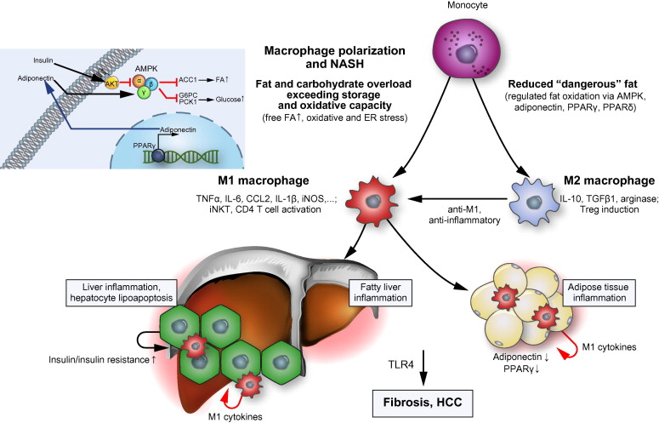
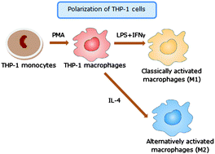

Slide 3
THP1 Floating cells
M0 Macrophage
M1 Macrophage
50nM PMA 1day
20ng/ml INF-γ,
10pg/ml LPS 2days
M1 differentiation
LMG374
THP1
M0
DMSO
ARR211
ARR235
TEPP46
TNF-α
β-actin
10µg loading, IL6 cannot detect.
Need BFA treat to block secretion
M1, M2 Macrophage differentiation with activators and BFA(block secret IL series) are going on.
THP1
M0 macrophage
M1 macrophage
TNF-a and IL6
M2 macrophage
CD206 and Fibronectin

Slide 4
BX decreased TAG in Huh7 steatosis model

Slide 5
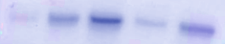
Huh7 1 week incubation with different media for steatosis
SM = Steatosis media(10µM T09, 10ng/µl insulin)
Huh7 cytosolic
HepG2 WT.
1week steatosis with drugs.
Whole lysate
DMEM SM
Control
DMEM
RPMI SM
RPMI
FASN
*
ACACA
*
LMG374 10µM
ARR211 10µM
ARR235 10µM
PKL
Control
BX 5µM
Aza 5µM
PKM
FASN
β-actin
PKL
PKM
Media specification
HepG2 WT.
1week steatosis with drugs.
Whole lysate
β-actin
RPMI-1640
L-alanyl-glutamine
Glucose 2000 mg/L
DMEM high-glucose
L-alanyl-glutamine
Glucose 4500 mg/L
Sodium pyruvate

